Slide 1
Strengthening the Competition Regime in Pakistan
Action Plan (2018-19)

Slide 2
Project Title: Strengthening The Competition Regime in Pakistan
Project Period Goal:

Slide 3
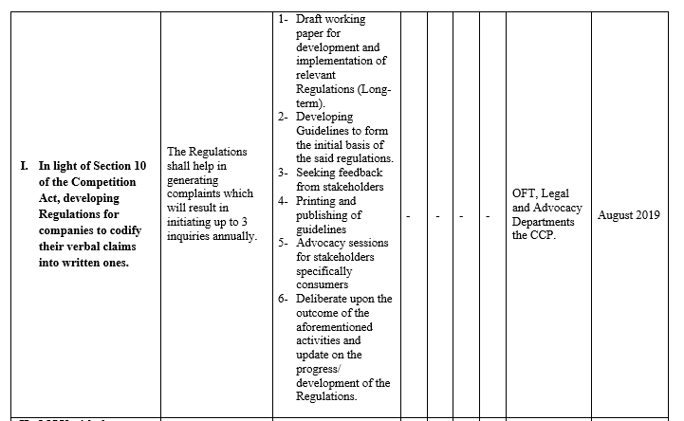
Deceptive Marketing Practices
Long term Objectives

Slide 4
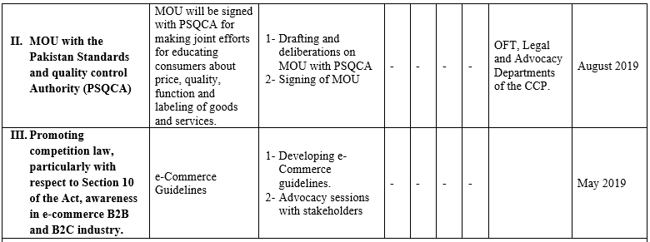
Deceptive Marketing Practices (Cont..)

Slide 5
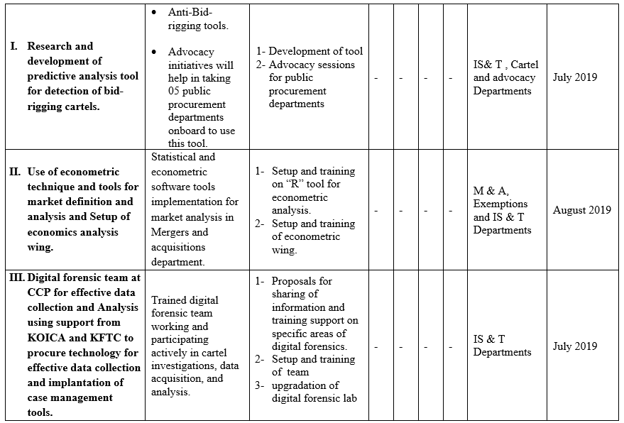
Anti-trust enforcement and information tech. Initiatives

Slide 6
Anti-trust enforcement and information tech. Initiatives (Cont..)

Slide 7
Advocacy

Slide 8
Thank You

